Slide 1
Bollinger Band-Stochastic Oscillator 5 Minute Scalping Strategy
This Strategy only used in Eur/USD pair.
Time frame should be M5
Lot size should be according to account balance / money management.
Insert Bollinger Band Indicator with by default values of 20 and green color
Insert 2nd Bollinger Band Indicator with by default values of 20 and red color but set deviation value 1.500.
Insert Stochastic Oscillator with by default values of 5,3,3.
TP Should be 3 pips & SL 2 pips far from last candle value.

Slide 2
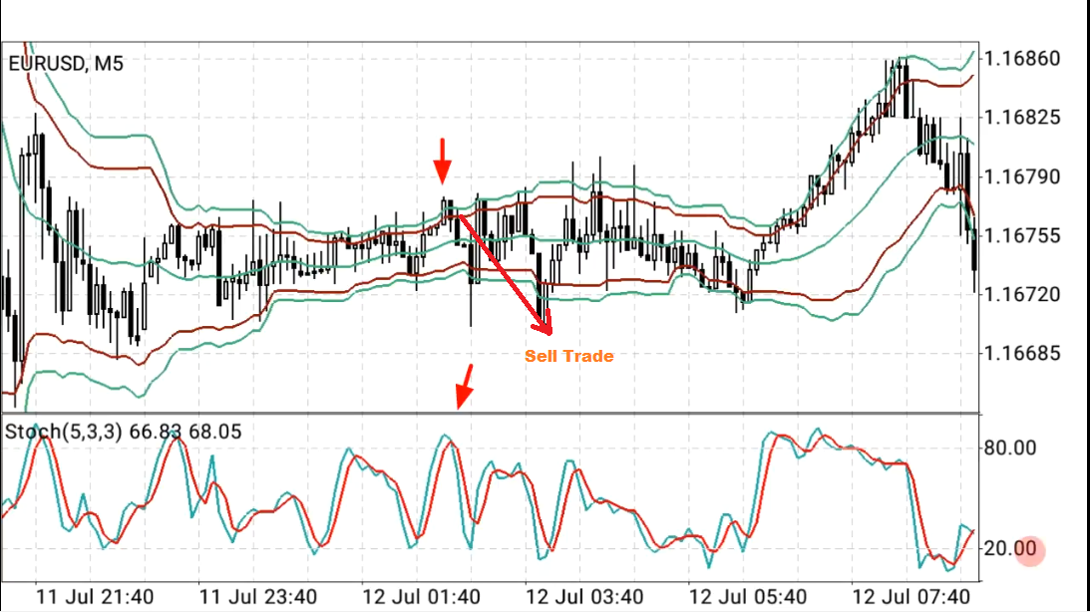
When candle closed outside the upper Bollinger Band green line & Stochastic Oscillator value show over the 80 line and next candle closed below both the upper Bollinger Band green and red lines, then there is sell trade at starting of new candle.

Slide 3
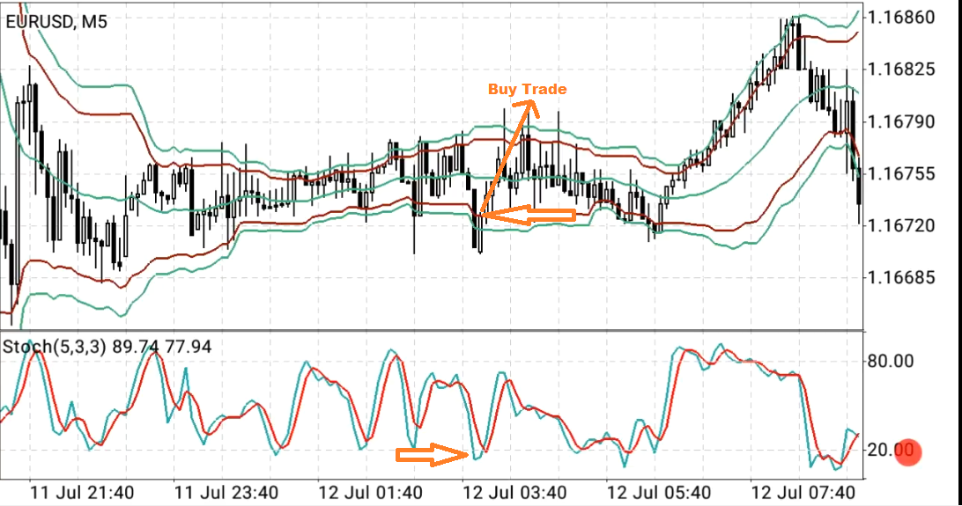
When candle closed outside the lower Bollinger Band green line & Stochastic Oscillator value show below the 20 line and next candle closed inside both the lower Bollinger Band green and red lines, then there is buy trade at starting of new candle.

