Slide 1
Hybrid 1 Chart Trading
Manual

Slide 2
Presets
Load the Hybrid 1 Chart Trading tool in Expert advisor of your Meta Trader5(MT5).
Show all 28 pairs from the Market Watch of your Meta Trader5.
Load the Dashboard and enter in full screen mode if needed
  Dashboard is designed for 14” displays and may not fit to the full screen in the other sizes

Slide 3
Hybrid 1 Chart Trading: About
Hybrid 1 Chart Trading is born based on the need of:
  Complete market follow up of the main currencies and their crosses
  Easiness of the trades and money management
  Different market approach
  Cross pairs approach, strength of the currency and micro trends identifications
  The tool of Hybrid 1 Chart Trading is developed and operationally tested for its functionalities more than one trimester and it passed trough above twenty versions of upgrade.
  Hybrid 1 Chart Trading is not a “Holy grail” and it have to be used very carefully after the necessary market knowledge and experience.

Slide 4
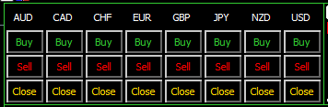
Trading group of pairs
The panel allows you to open positions in the direction of each pair
For example: Buy AUD will open 7 positions, on all the pairs, in the direction of the AUD ; Sell CAD will open 7 positions, on all the pairs, against CAD
Close button will close open positions per respective group
1
2
3
1. Close +, closing all the deals which at the moment are on +
2. Close -, closing all the deals which at the moment are on –
3. Closing All, closing all active deals

Slide 5
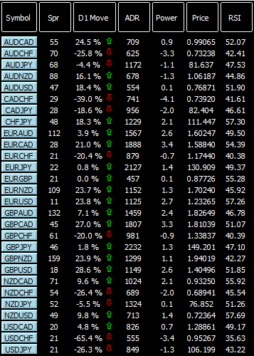
Data and fast buttons
1
2
3
4
5
6
7
1. Symbol, Fast buttons when pushing for a pair will open you the chart of this pair in the default save template format. It will open you the chart in the same TF as the EA in attached to
2. Spr, spread per pair
3. D1 Move, represents the % of the Daily move vs ADR
4. ADR, Average Daily Range for the last ADR days. ADR days can be set in the settings of the of the EA
5 Power, difference between the power of each currency
6. Price , current price
7. RSI, RSI value per pair on the current TF on which the EA is attached

Slide 6
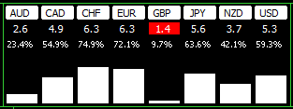
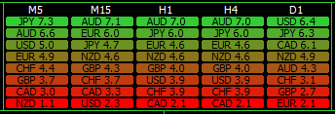
Power of the currency
Display* shows the actual power of each currency. Below 2, highlights in red and above 7, in green
* Do not use the Display around a Day change due to the reset of the Broker’s servers it can mislead you(Day change depends of your time zone)
Display shows the power of each currency per timeframe. Time frame could be adjusted in the “Multi Time Frame Settings” in the initial settings of the EA

Slide 7
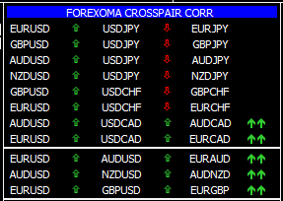
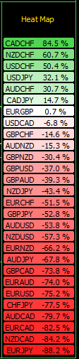
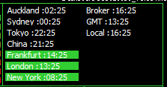
Supporting Tools
Forexoma is showing you Dynamic Correlation of the Cross pairs according to the move of main pairs vs their Daily move
Heat Map* is providing an idea of the current tendency of the pairs
* Do not use the Heat Map around a Day change due to the reset of the Broker’s servers it can mislead you(Day change depends of your time zone)
Display shows the opening hours of the Stock Exchange, Local time, Broker time and GMT

Slide 8
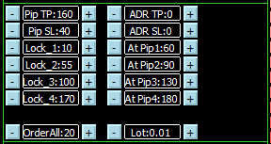
Supporting tools
1
2
1. Pip TP/Pip SL – manually set up of the TP and SL in the settings, fast correction with the +/- buttons
2. ADR TP/ ADR SL – set up of the TP and SL based on the Average Daily Range
3. 4 levels of jumping SL set in EA settings, fast correction with the +/- buttons Lock_1/4 X pips when reaches number of XX pips At Pip1/4
4. Order All, total number of open deals in one and the same time, fast correction with the +/- buttons
5. Lot, size per deal, fast correction with the +/- buttons, option for using money management and risk % from the settings of the EA
3
4
5

Slide 9
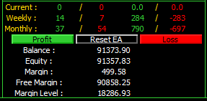
Performance summary
1
2
1. Information of the number of deals Buy/Sell
2. Profit/Loss from the deals in pips
  Periods
    Current – active deals
    Weekly – deals during the last week
    Monthly – deals during the current month
3. General information for the account
3

Slide 10
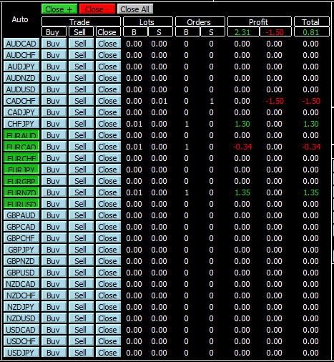
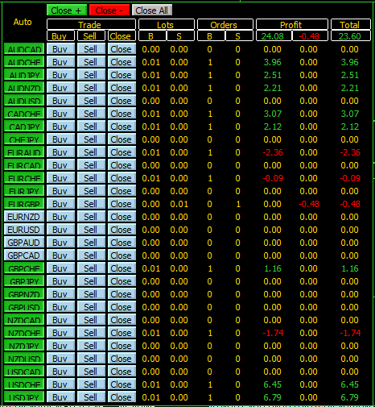
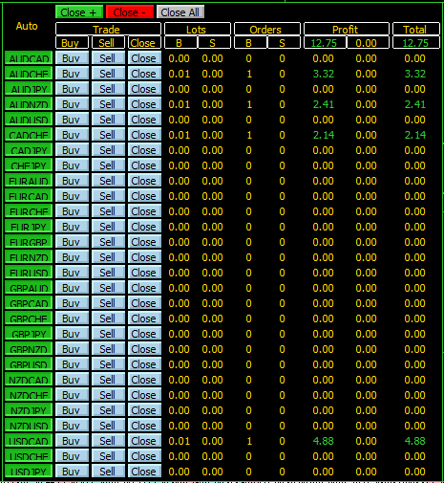
Auto/Manual trading, performance follow up
1
2
3
4
5
6
1. Auto, green color indicates that the Auto-trading is turned on. Can be set for each pair from the settings, or directly from the screen
2. Trade
  Buy, manual execution of a deal
  Sell, manual execution of a deal
  Close, manual execution of a deal
3. Lots, information of the size of the open position B(buy)/S(sell)
4. Orders, number of open orders, B(buy)/S(sell)
5. Profit, in the account currency from Buy/Sell deals
6. Total performance in account currency

Slide 11
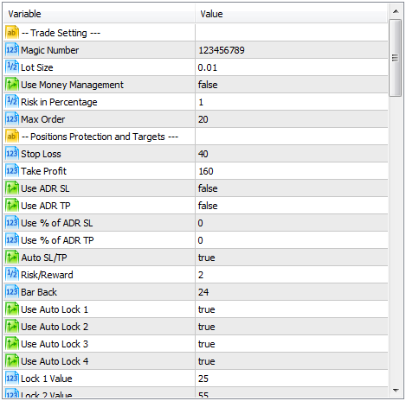
Settings of the EA and Auto-trading ideas
1
1. Trade Settings
  Magic Number, number based n which the EA follows its open positions
  Lot Size, manually applying the size of the deals opening
  Use Money Management, if true automatic calculation of the lot size based on the Risk in Percentage
  Risk in Percentage, calculates the percentage of risk for the size of the deal when opening
  Max Orders, maximum number of deals open in one and the same time

Slide 12
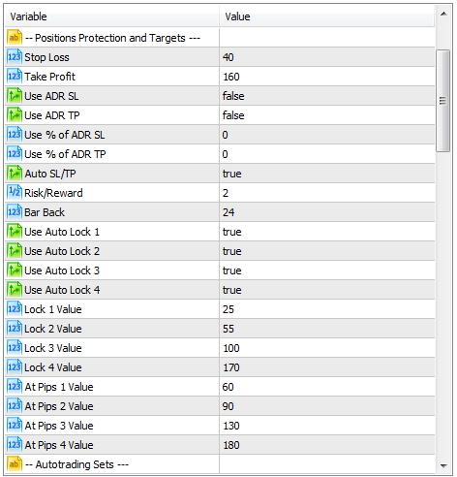
Settings of the EA and Auto-trading ideas
2. Position Protection and Targets
  Stop Loss/Take Profit, manual adjustment
  Use ADR SL/TP, when true follows the % adjusted in the Use % of ADR SL/TP
  Use % of ADR SL/TP, calculating the SL/TP based on the Average Daily Range for the last x Days
  Auto SL/TP, when true calculates automatically the SL/TP based on the Risk/Reward and Bar Back, and applying it on min/max of the candles
  Risk/Reward – represents the factor for increasing the TP based on the SL
  Bar Back – number of the candles in which have to look back for min/max
  Use Auto Lock 1/4 , allows you to use a jumping stop loss for protecting the deals on +, 4 different levels
  Lock 1/4 Value, when the price reaches At Pip 1/4 Value the stop loss is moving at the level of the lock value
  At Pip 1/4 Value, when the price reaches the mentioned value, the stop loss is moving at the corresponding Lock Value
2

Slide 13
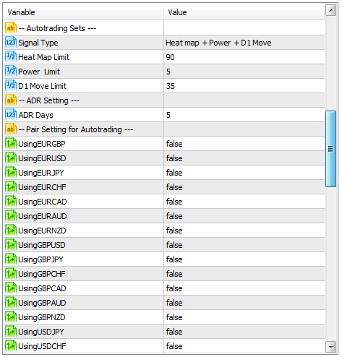

Settings of the EA and Auto-trading ideas
3
3. Autotrading Sets
  Signal Type, describes the algorithm for Auto-trading method*
    Heat map – EA open deals only when the Heat Map Limit is respected. Example: Heat Map Limit = 90, EA will open deals only on the currencies which are >90 and < -90
    Heat map + Power - EA will open deals only when both of the conditions(Heat Map Limit+Power) are respected. Example: Heat Map Limit = 90, Power=5, EA will open deals only on the currencies which are >90 and < -90, and difference in the power between the currencies is >5
    Power - EA will open deals only when the Power is respected. Example: Heat Map Limit = 90, Power=5, EA will open deals only on the currencies which are >90 and < -90, and difference in the power between the currencies is >5
    Heat map + Power + D1 Move - EA will open deals only when three of the conditions(Heat Map Limit+Power+D1 Move) are respected. Example: Heat Map Limit = 90, Power=5, D1 Move=35 EA will open deals only on the currencies which are >90 and < -90, and difference in the power between the currencies is >5, and D1 Move < 35 % of ADR
* Using of the Auto-trading option may put your account at risk and it is strongly recommended to be tested first on demo accounts

Slide 14
Settings of the EA and Auto-trading ideas
4. Autotrading Sets
  Heat Map Limit, describes tendency of the pair to go up/down. The Autotrading is opening a deal if value set is above X. The autotrader will open a deal if value is above 90 (+90 or -90)
  Power limit, indicated the gap between powers to open a deal in the Autotrading mode
  D1 Move limit, indicates the daily move vs the average daily range from the last X ADR Days
5. ADR Settings
  ADR Days, the value is indicating how many days back to calculate the Average Daily Range
6. Pair setting for Autotrading
  UsingPair/Pair, if true will automatically open a deal based on the Signal Type conditions. This options allows you to trade only limited number of pairs
4
5
6

Slide 15
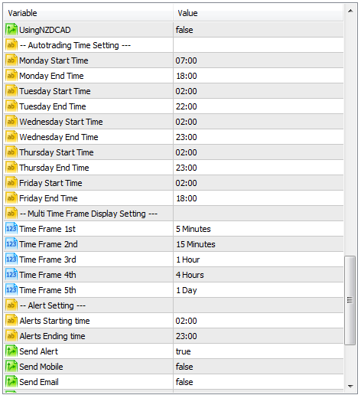

Additional Settings
7. Autotrading Time Settings
  Monday/Friday Start/End Time, indicates the Day and working period of the Autotraidng mode
8. Multi Time Frame Display Settings
  Time Frame 1st / 5th, 5 different time frames of the of the Power of the currency
9. Alert Settings
  Alert Starting/Ending Time, configures the period in which the Alert will be fired
  Send Alert/Mobile/Email, if true sending alert accordingly on Desktop/Mobile platform on the phone/Email box
10. RSI Settings
    RSI Period, configures the period for the RSI accordingly to the time frame on which the EA is attached
7
8
9
10

