Slide 1
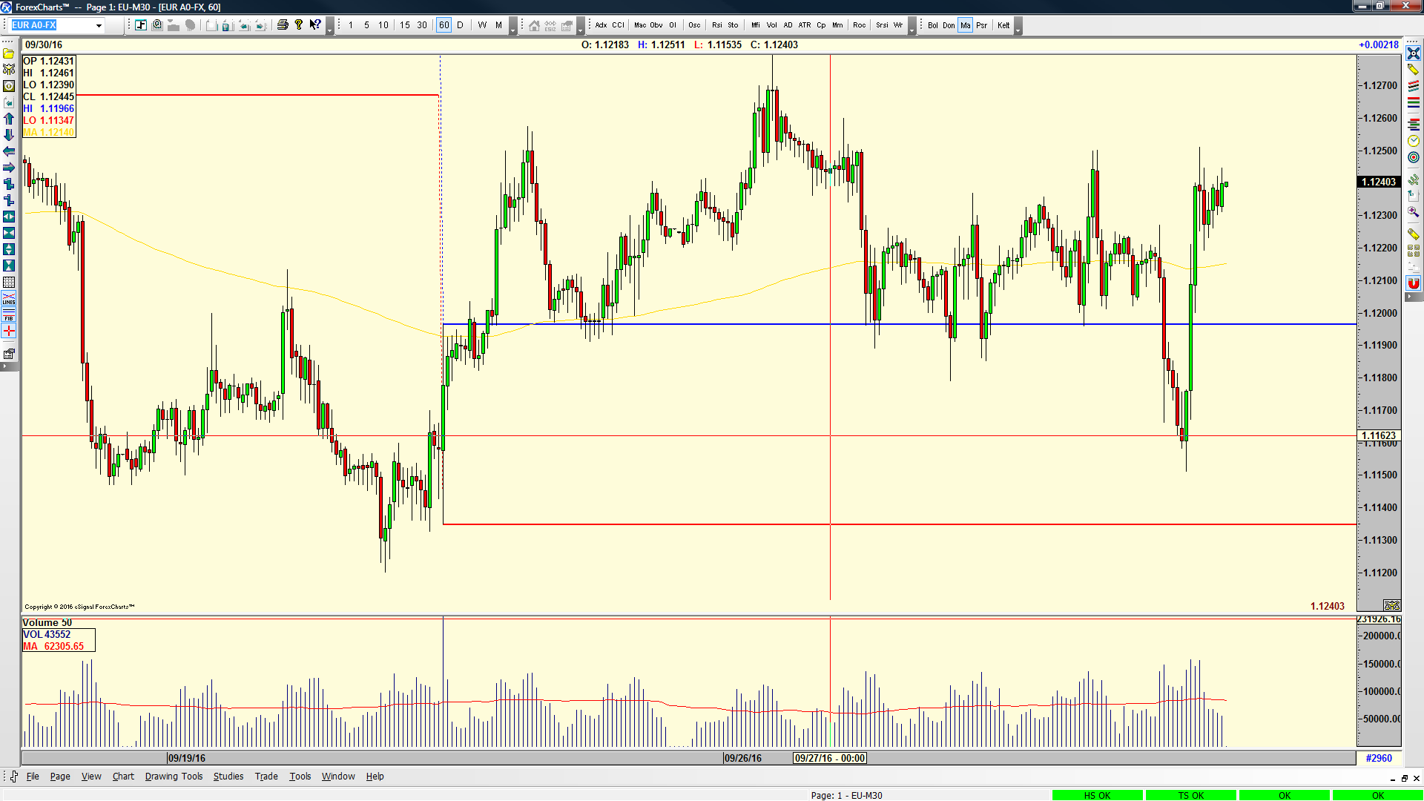

Slide 2
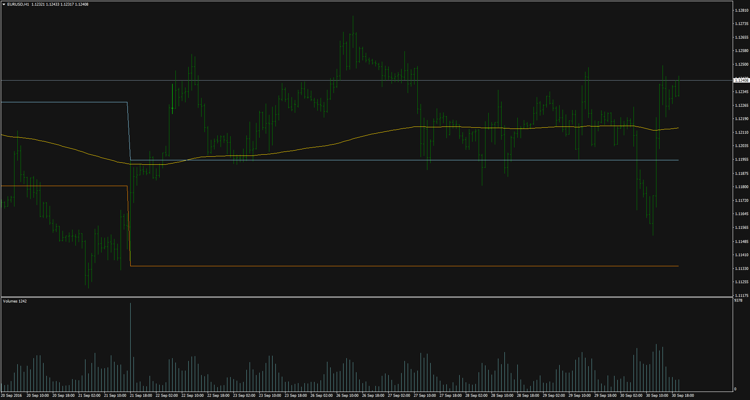
EURUSD, H1,AVA

Slide 3
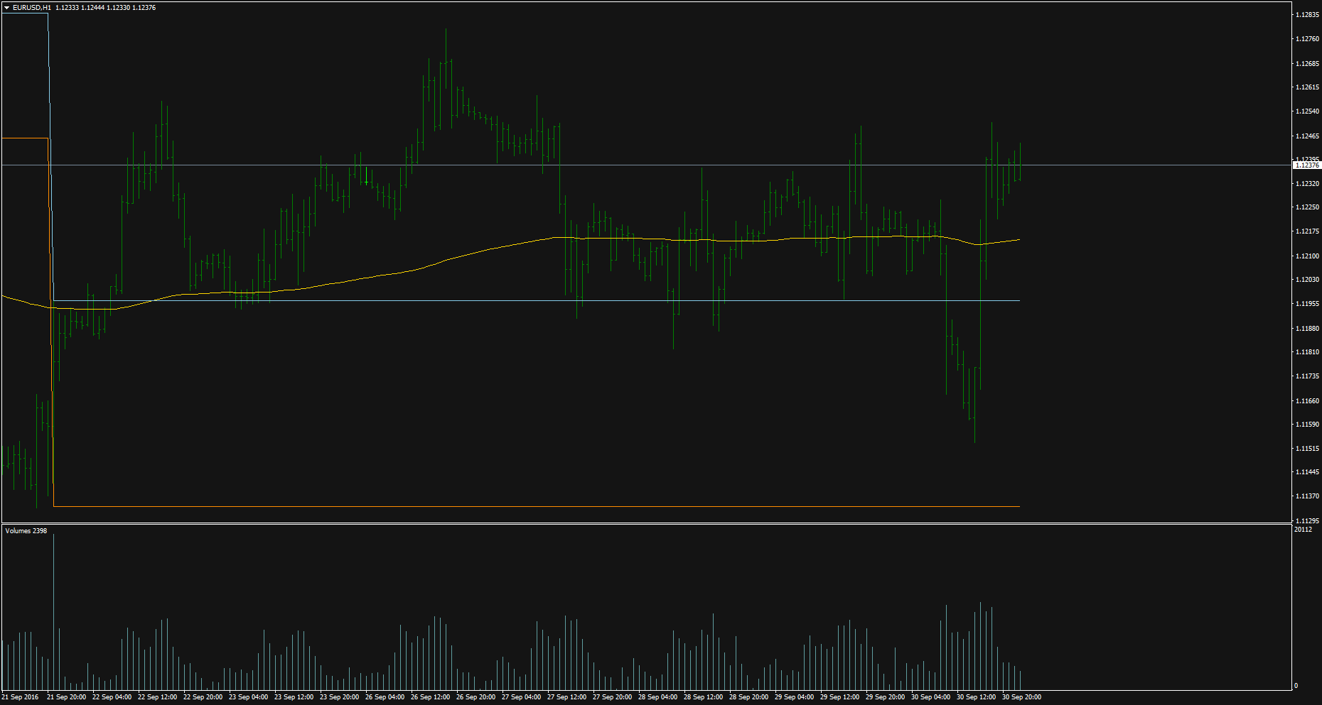
EURUSD, H1,FXCM

Slide 4
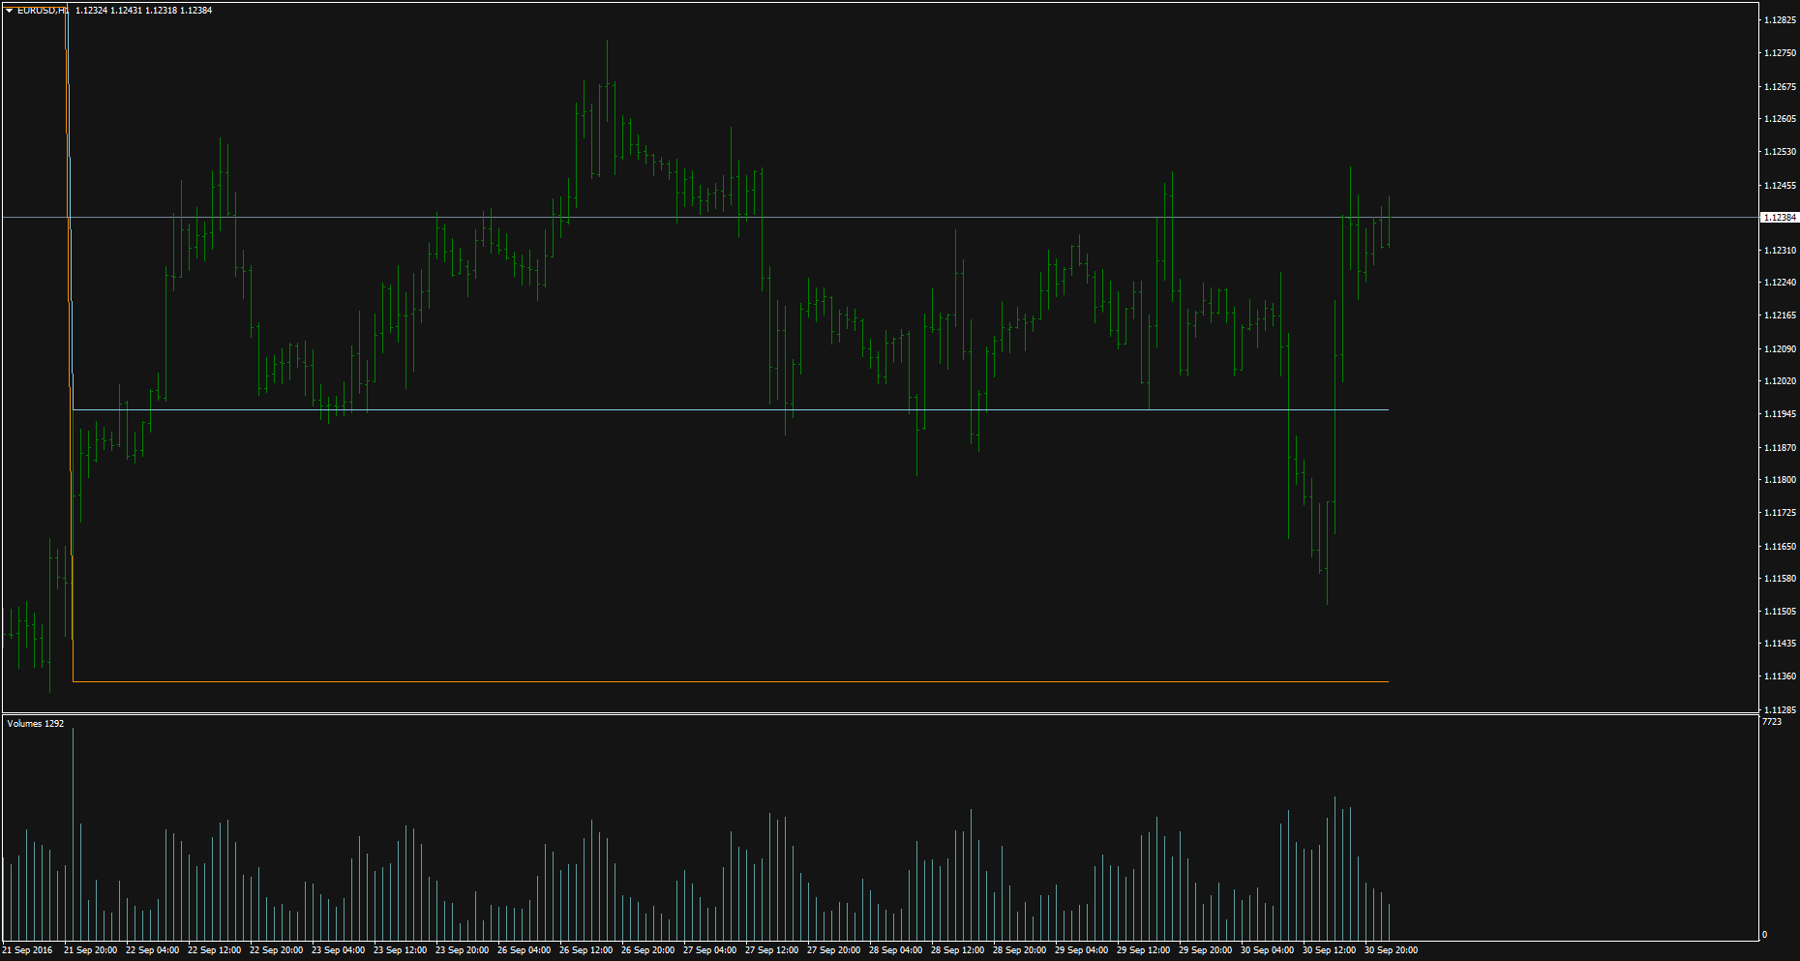
EURUSD, H1,WD

Slide 5
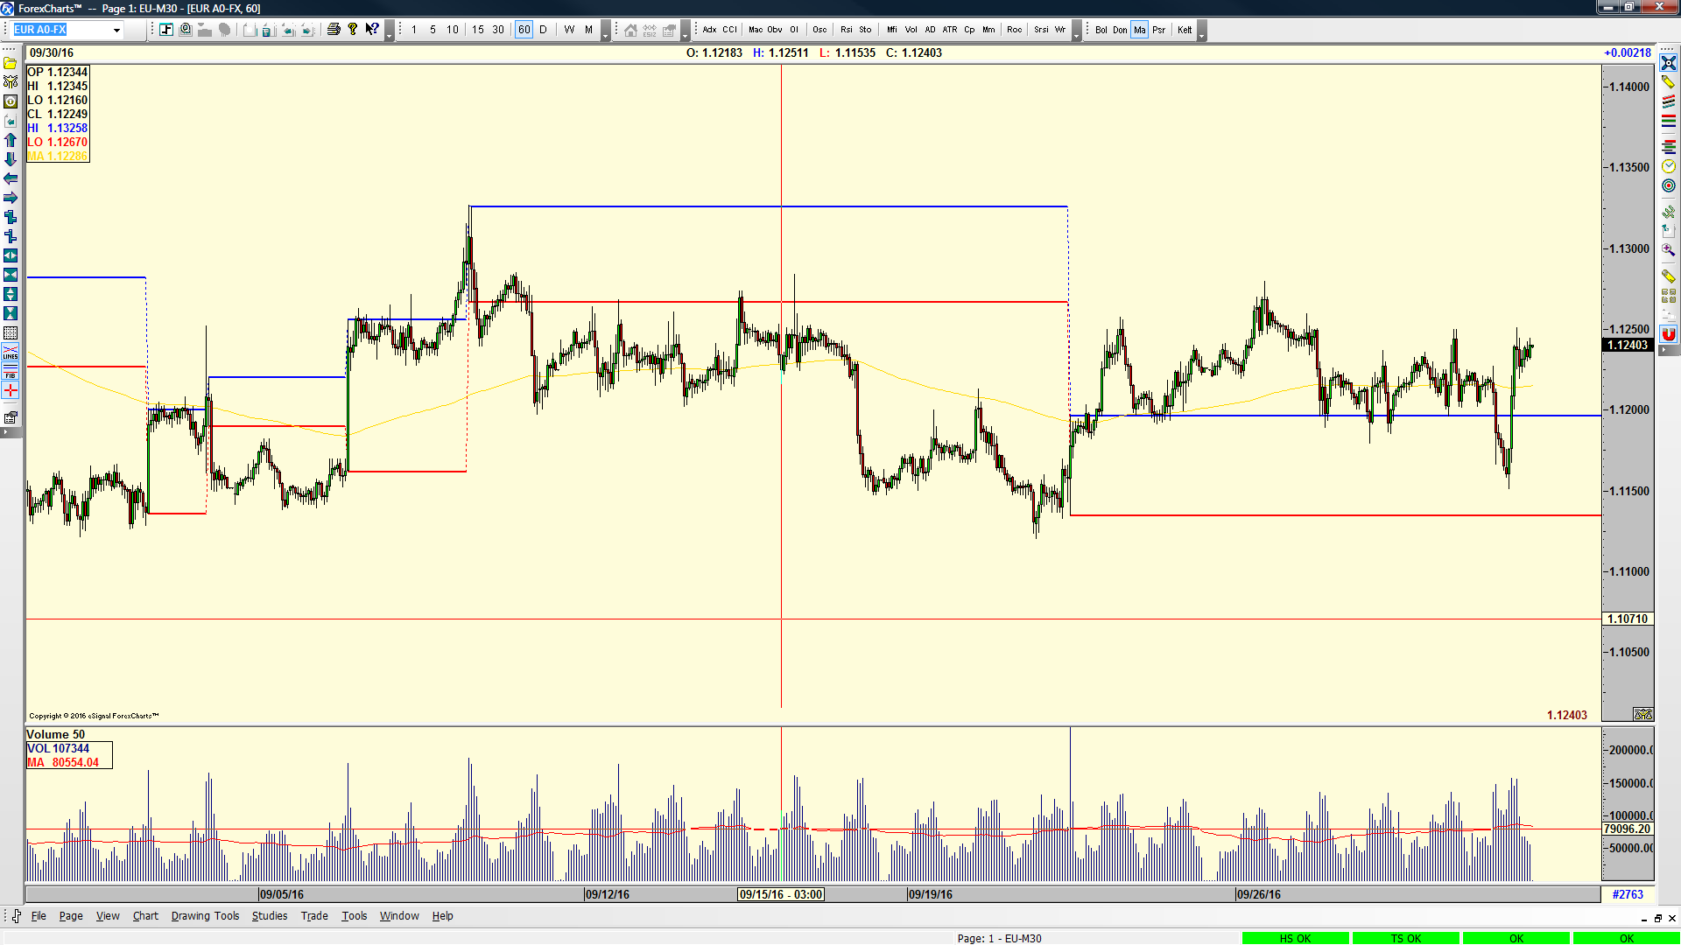

Slide 6
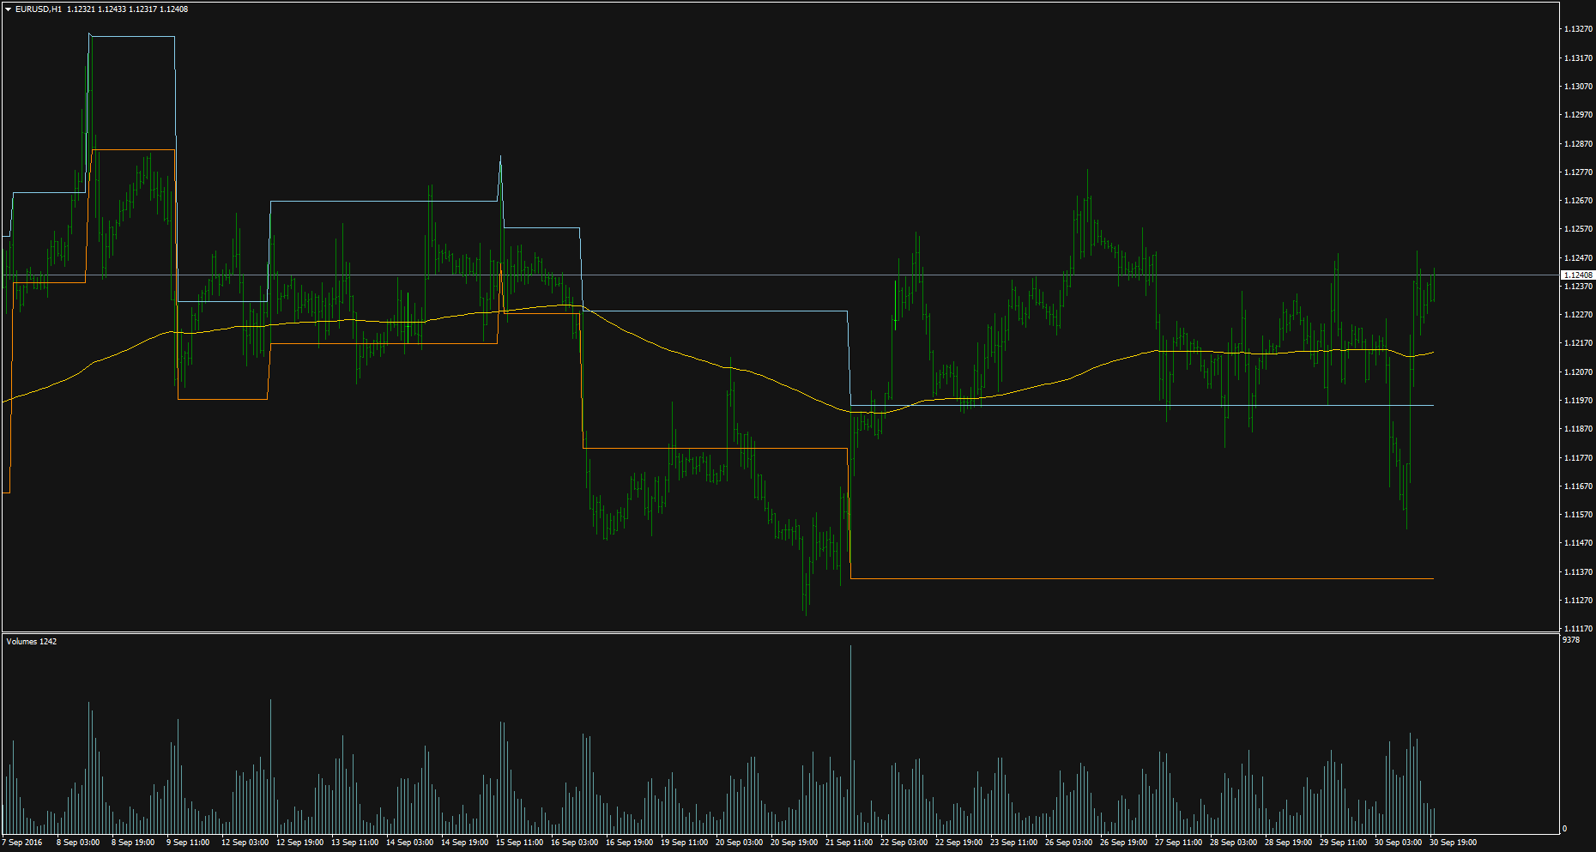
EURUSD, H1,AVA-1

Slide 7
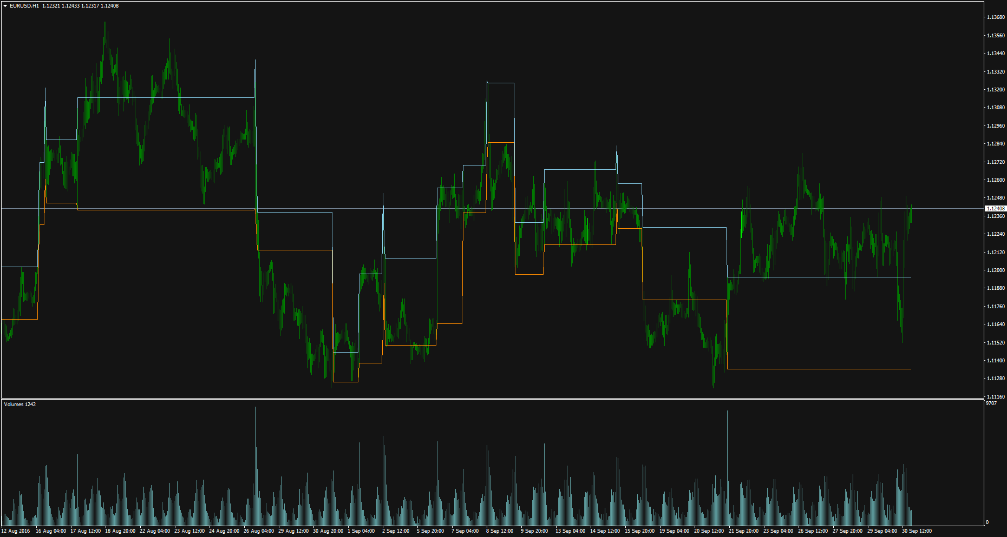
EURUSD, H1,AVA-2

Slide 8
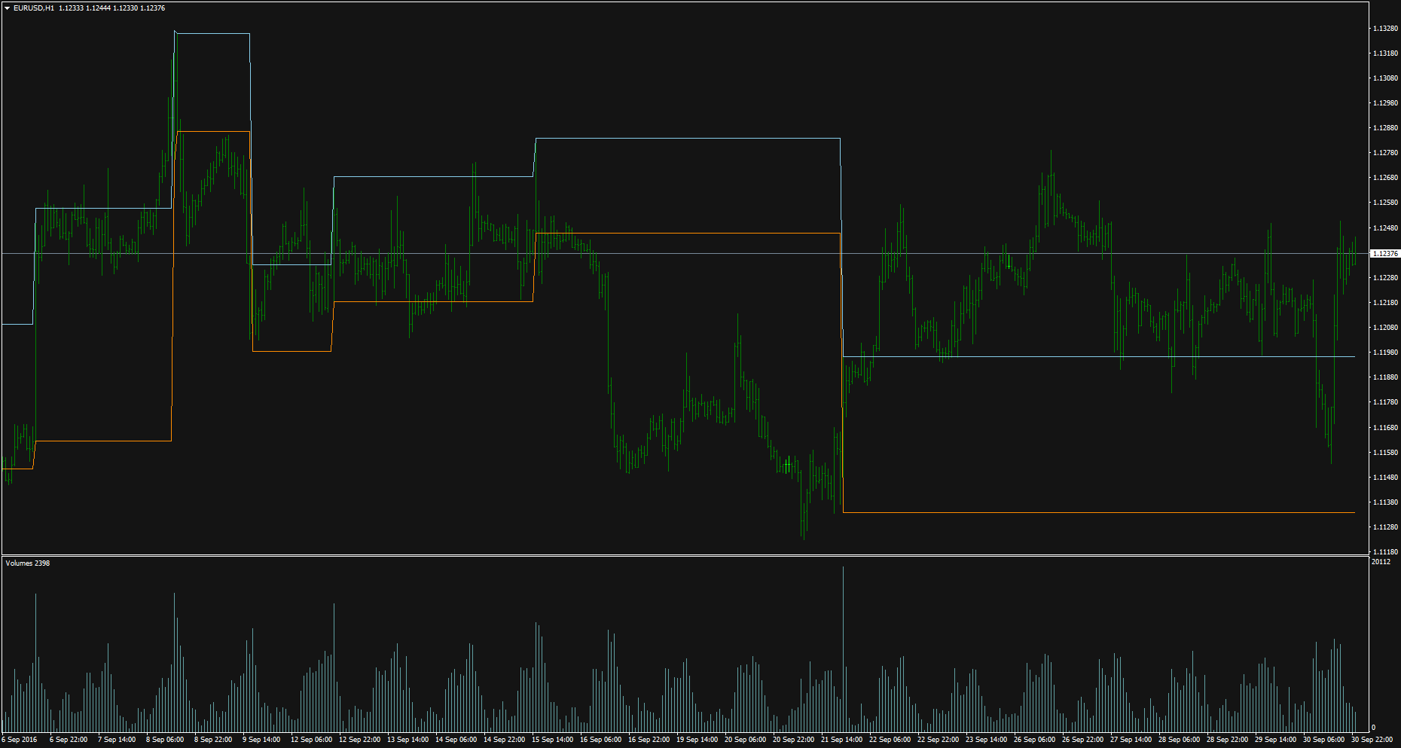
EURUSD, H1,FXCM-1

Slide 9
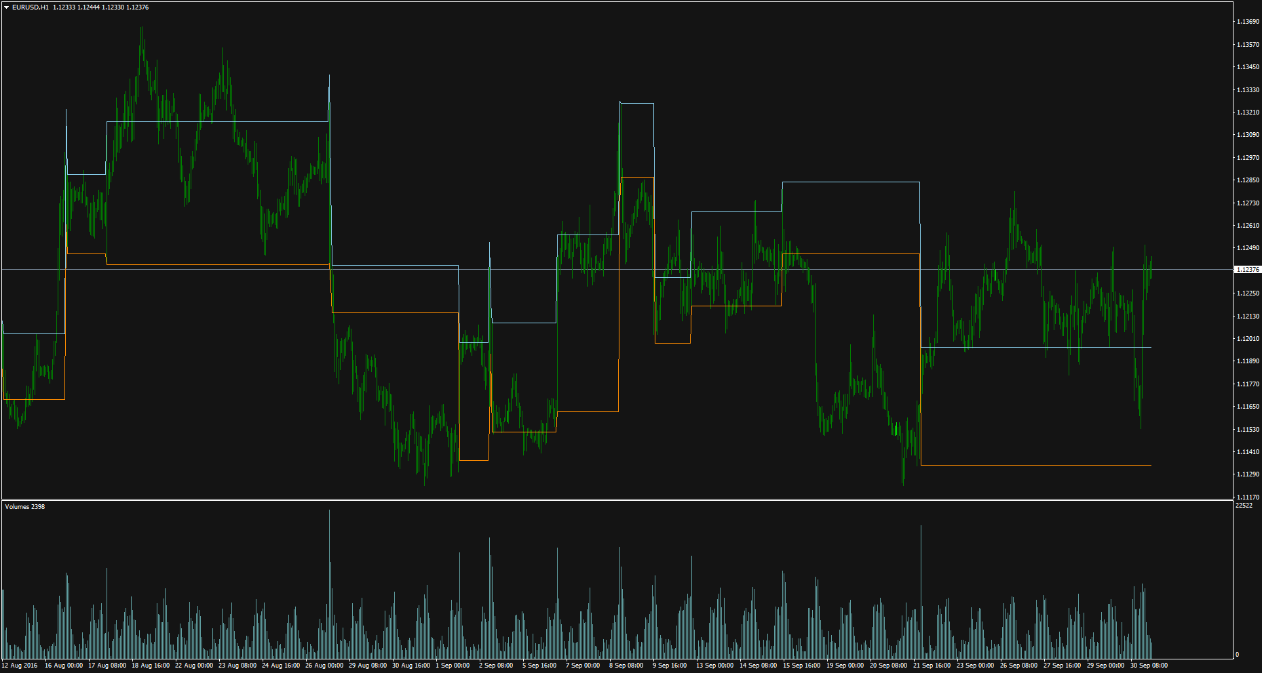
EURUSD, H1,FXCM-2

Slide 10
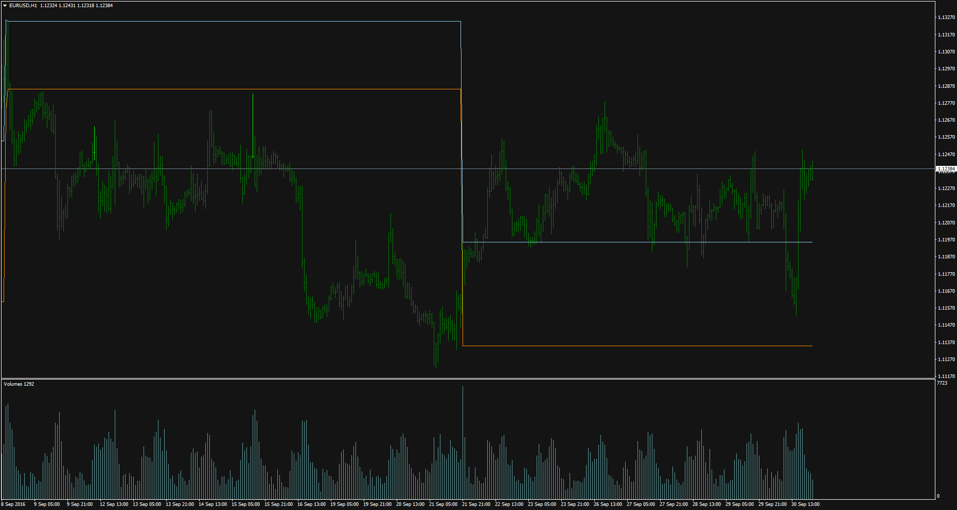
EURUSD, H1,WD-1

Slide 11
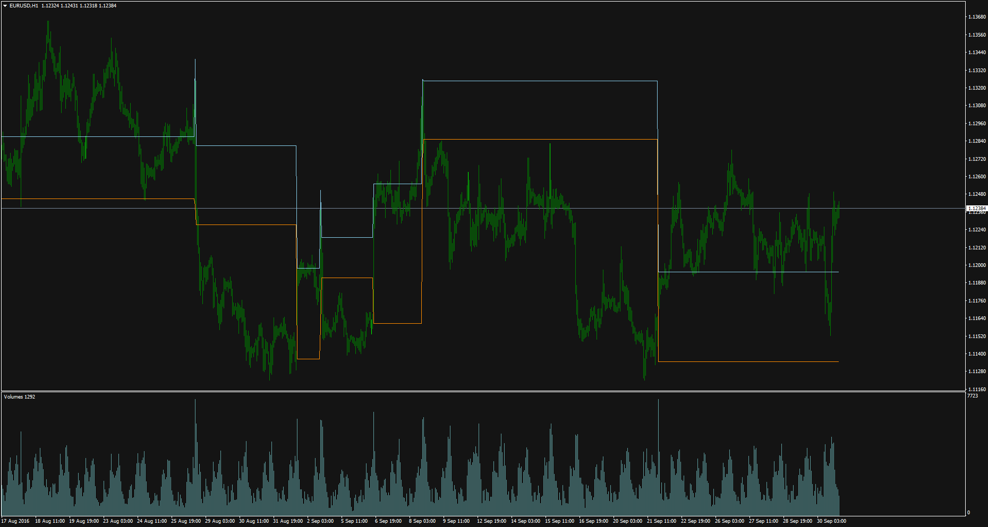
EURUSD, H1,WD-2

Slide 12
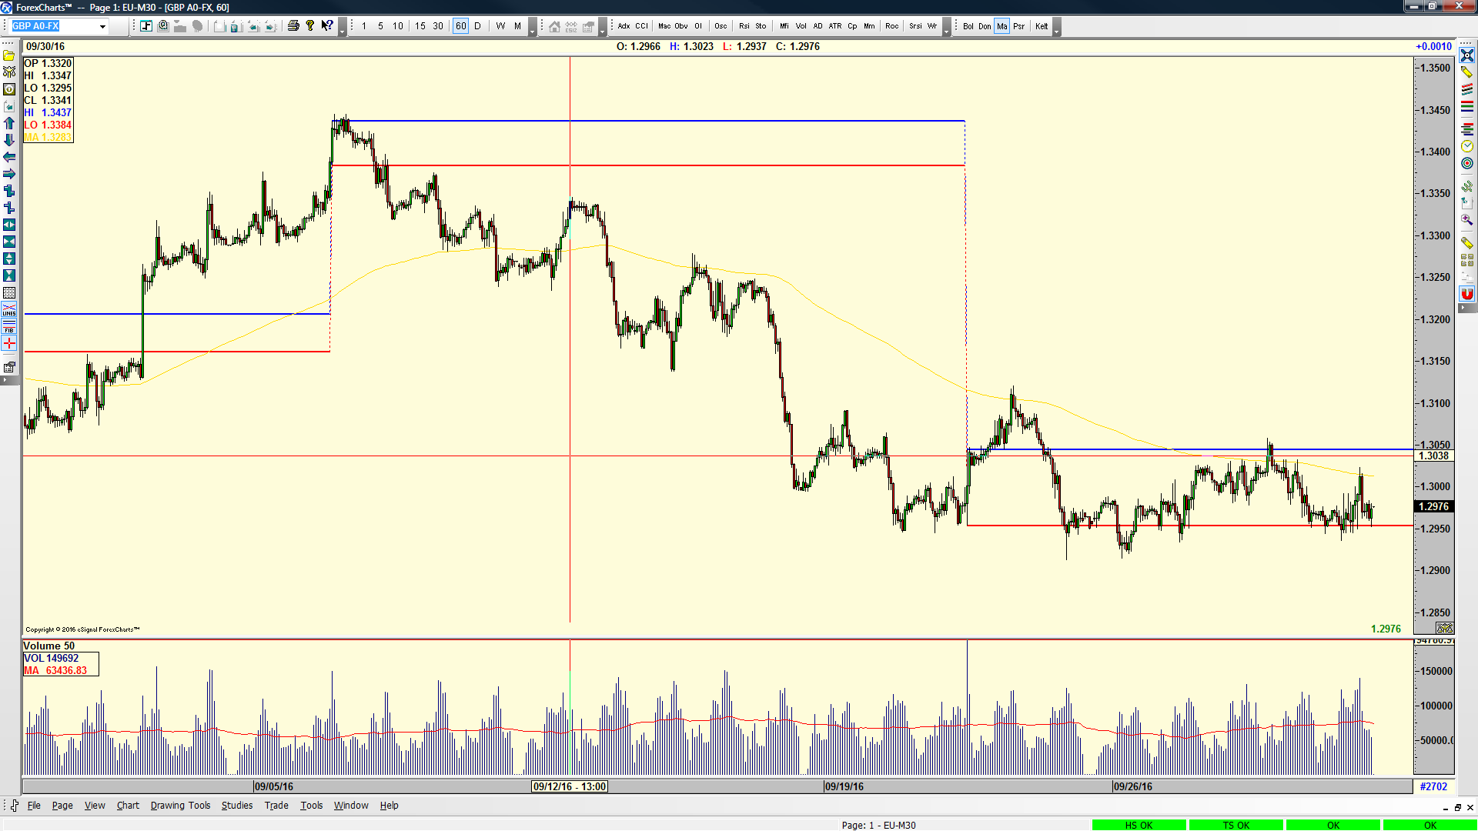

Slide 13
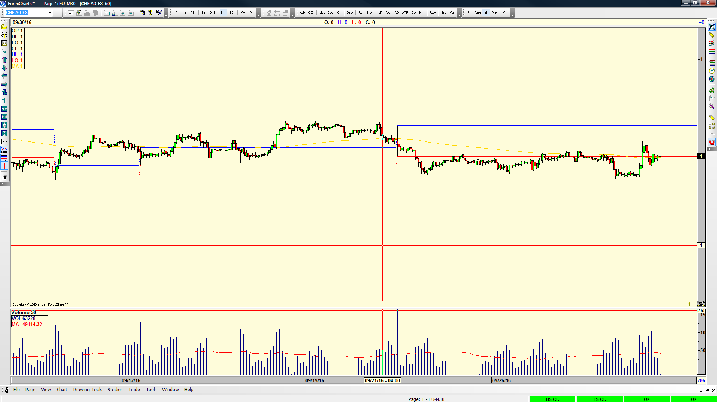

Slide 14
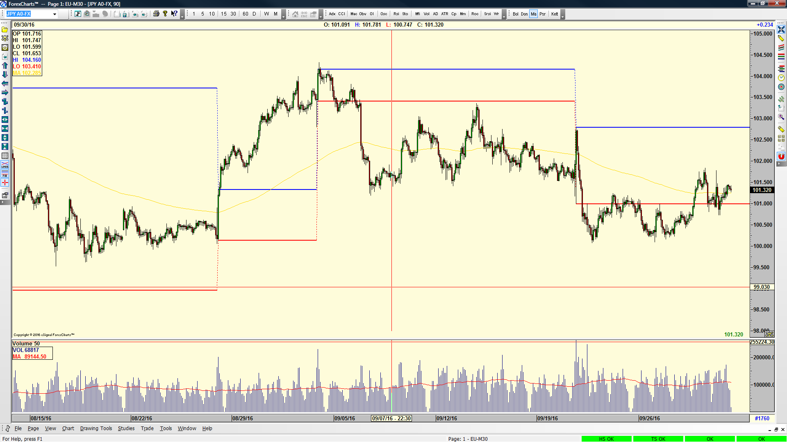

Slide 15
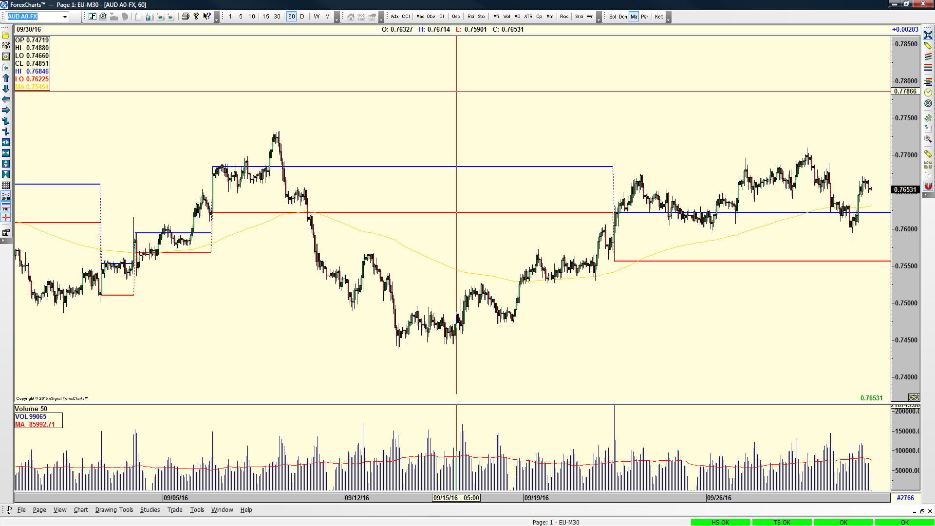

Slide 16
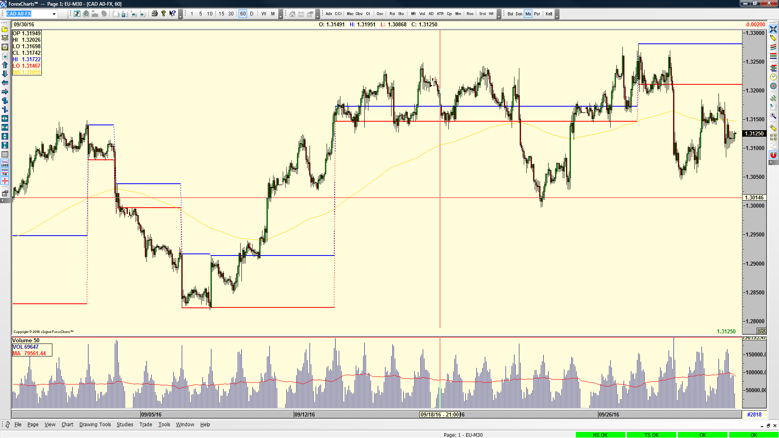

Slide 17


