Slide 1
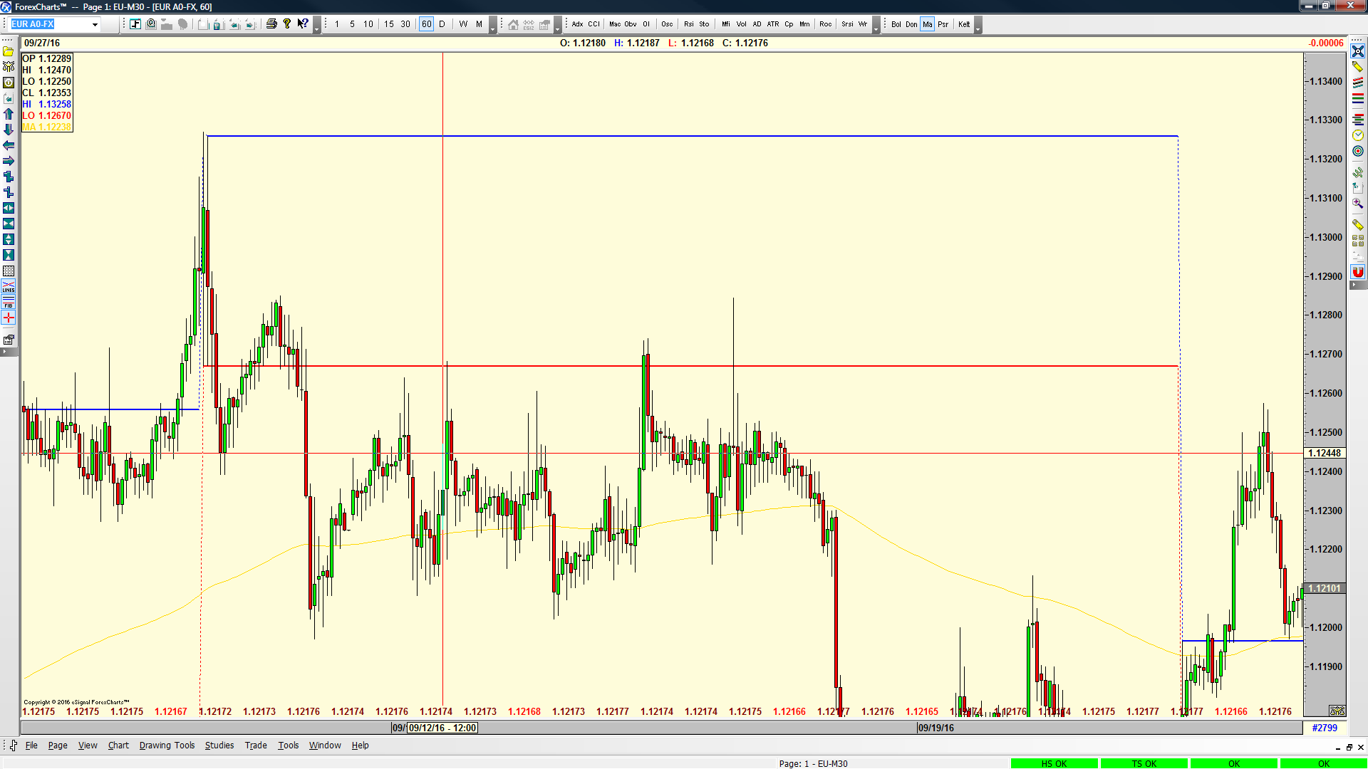
E URUSD, H1, esignal

Slide 2
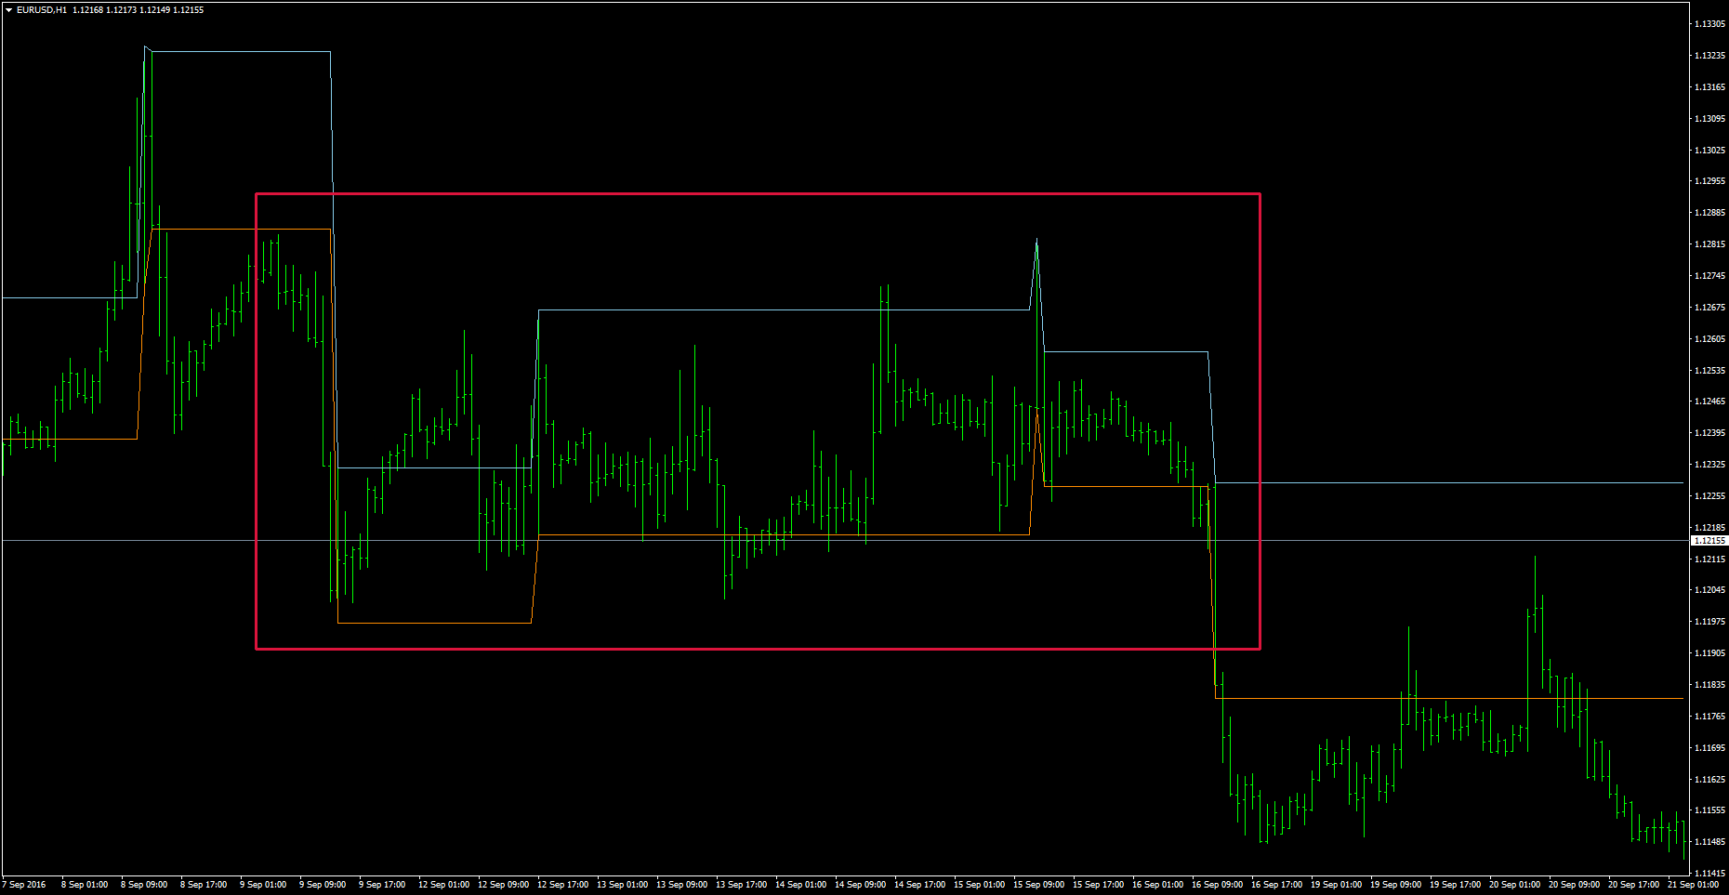
EURUSD, H1, AVA

Slide 3
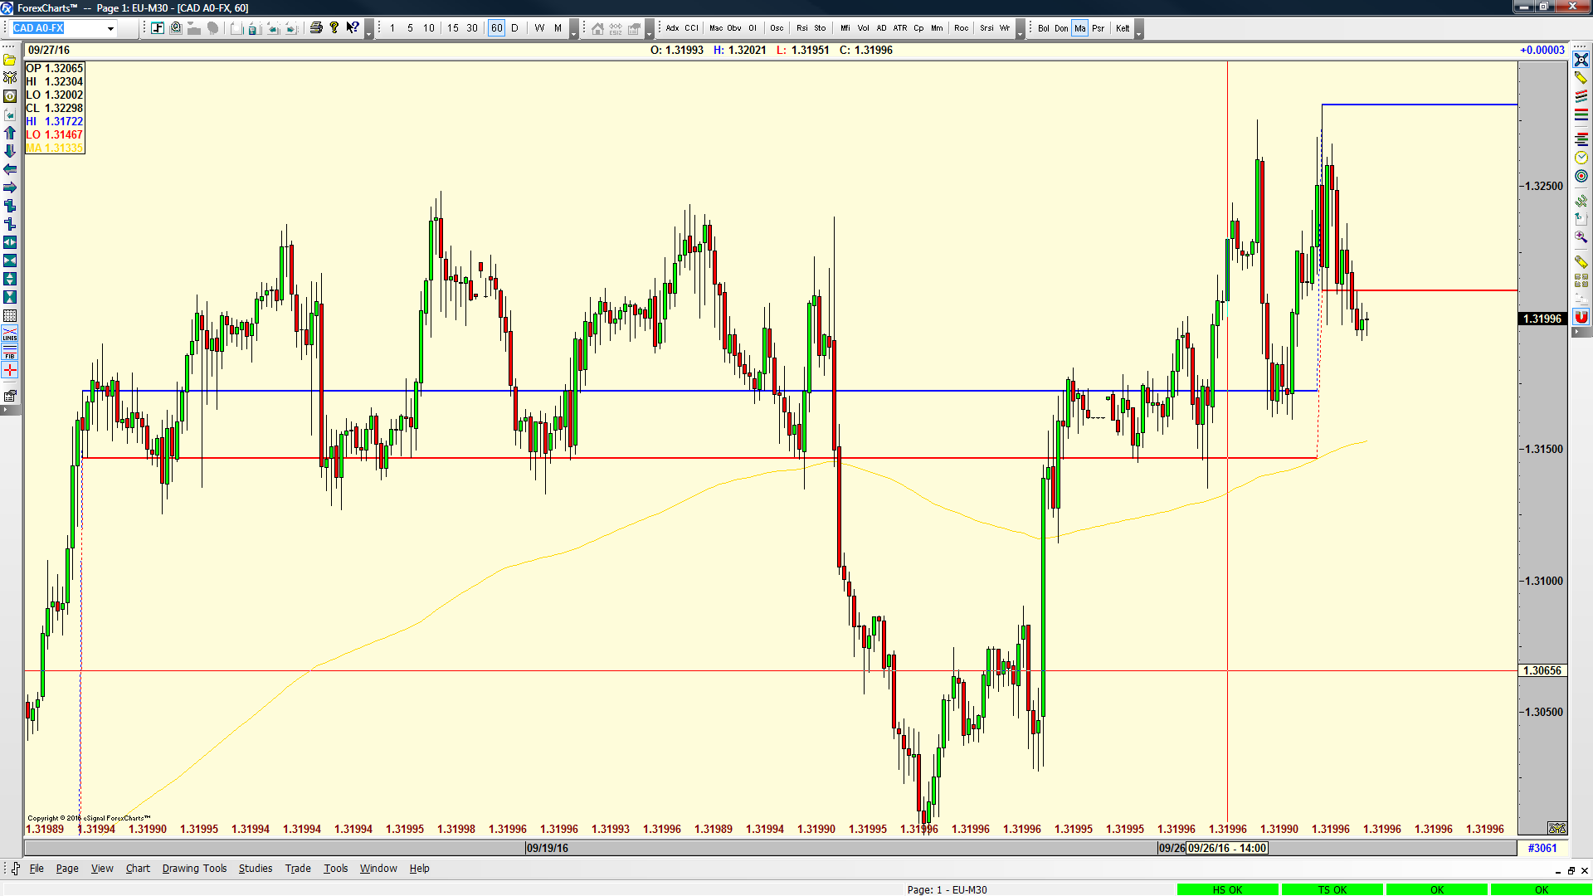
USDCAD,H1, esignal

Slide 4
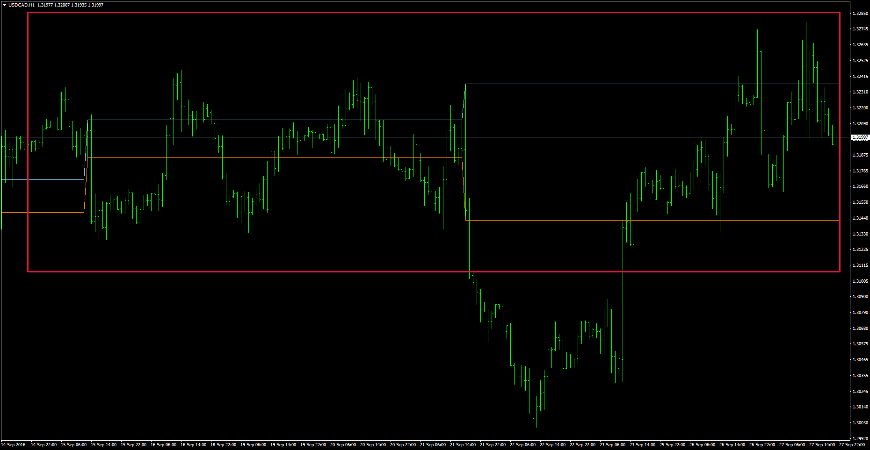
USDCAD, H1, AVA

Slide 5
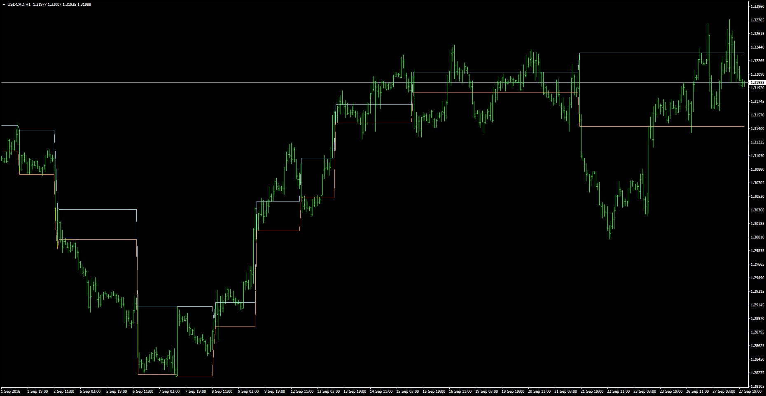
USDCAD, H1, AVA

Slide 6
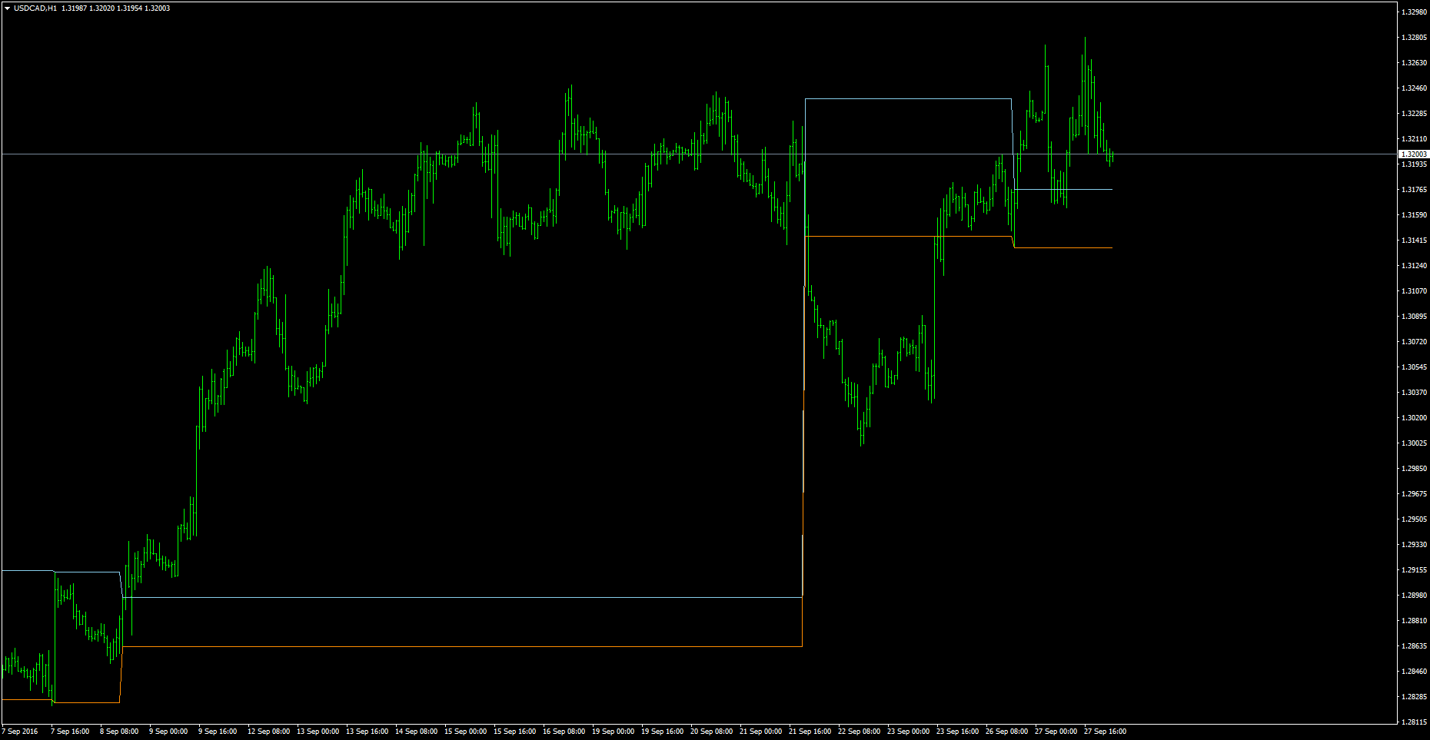
USDCAD, H1, FXCM

Slide 7
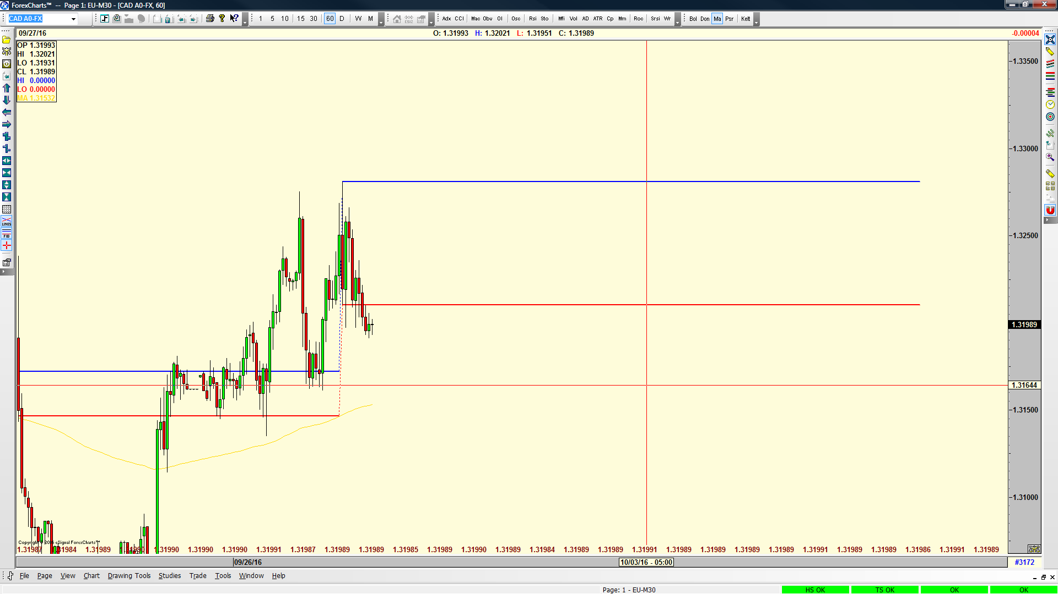
USDCAD,H1,AVA, end of lines, beyond bars…

